Slide 1
Beyond Classical Search Chapter 4

Slide 2
Local search algorithms
In many optimization problems, the path to the goal is irrelevant; the goal state itself is the solution
State space = set of "complete" configurations
Find configuration satisfying constraints, e.g., n-queens
In such cases, we can use local search algorithms
keep a single "current" state, try to improve it

Slide 3

Example: n-queens
Put n queens on an n × n board with no two queens on the same row, column, or diagonal

Slide 4
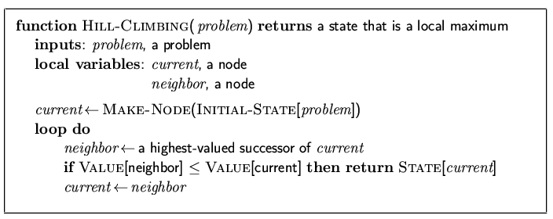
Hill-climbing search
"Like climbing Everest in thick fog with amnesia"

Slide 5
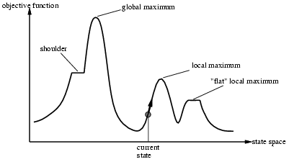
Hill-climbing search
Problem: depending on initial state, can get stuck in local maxima

Slide 6
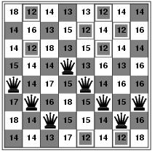
Hill-climbing search: 8-queens problem
h = number of pairs of queens that are attacking each other, either directly or indirectly
h = 17 for the above state

Slide 7
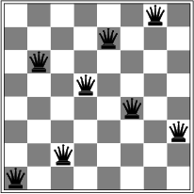
Hill-climbing search: 8-queens problem
A local minimum with h = 1

Slide 8
Simulated Annealing
Annealing is the process of metal casting, where the metal is first melted at a high temperature beyond its melting point and then is allowed to cool down until it returns to the solid form. Thus in physical process of annealing, the hot material gradually loses energy and finally at one point of time reaches a state of minimum energy.
A common observation is that most physical processes have transitions from higher to lower energy states, but there still remains a small probability, p, that it may move up to a higher energy state.

Slide 9
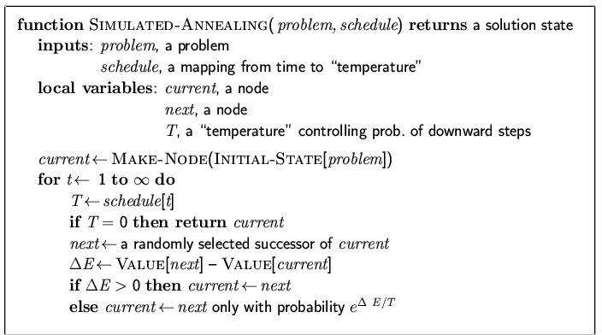
Simulated annealing search
Idea: escape local maxima by allowing some "bad" moves but gradually decrease their frequency

Slide 10
Properties of simulated annealing search
One can prove: If T decreases slowly enough, then simulated annealing search will find a global optimum with probability approaching 1
Widely used in VLSI layout, airline scheduling, etc

Slide 11
Local beam search
Keep track of k states rather than just one
Start with k randomly generated states
At each iteration, all the successors of all k states are generated
If any one is a goal state, stop; else select the k best successors from the complete list and repeat.

Slide 12
Genetic Algorithm (GA)
An adaptation procedure based on the mechanics of natural genetics and natural selection
Survival of the fittest
Recombination
Representation
Chromosome = string
Gene = single bit or single subsequence in string, represents 1 attribute
A GA maintains a collection or population of chromosomes
Each chromosome in the population represents a different guess of the solution

Slide 13
The GA Procedure
Initialize a population (of solution guesses)
Do (once for each generation)
Evaluate each chromosome in the population using a fitness function
Apply GA operators to population to create a new population
Finish when solution is reached or maximum number of generations/iterations have reached.

Slide 14
GA Operators
Reproduction
Crossover
Mutation

Slide 15
Reproduction
Select individuals x according to their fitness values f(x)
Fittest individuals survive (and possibly mate) for next generation

Slide 16
Crossover
Select two parents
Select crossover site/position
Cut and splice pieces of one parent to those of the other
1 1 1 1 1
0 0 0 0 0
1 1 0 0 0
0 0 1 1 1

Slide 17
Mutation
With small probability, randomly alter 1 bit
Pushes out of local minima
Population:
1 1 0 0 1 0
1 0 1 0 1 0
1 0 0 1 0 0
0 1 0 0 0 0
Goal: 0 1 1 1 1 1
Mutation needed to find the goal

Slide 18
1000
500 -
f(x)
0
0 x 31
Find maximum of f(x)= x² in the interval [0,31]

Slide 19
As interval is of length 32, choose string length as 5(2⁵ = 32)
Assume population size = 4
Initial population chosen by repetitions of five coins tosses where head = 1 , Tail = 0.
Crossover probability assumed to be unity.
Mutation probability assumed to be 0.001.
Expected mutations = 5*4*0.001 = 0.02

Slide 20
Sample problem strings and Fitness Values
No. String x fitness fi/Σfi fi*n Actual
----------------------------x²------pselecti---Expected count-----Count--
1 01101 13 169 0.14 0.58 1
2 11000 24 576 0.49 1.97 2
3 01000 8 64 0.06 0.22 0
4 10011 19 361 0.31 1.23 1
-----------------------------------------------------------------------------------
Sum 1170 1.00 4.00 4.0
Average 293 0.25 1.00 1.0
Max 576 0.49 1.97 2.0

Slide 21
Mating Pool Mate Crossover site New Population x f(x)=x²
------------------------------------------------------------------------------------------------
01101 2 4 01100 12 144
11000 1 4 11001 25 625
11000 4 2 11011 27 729
10011 3 2 10000 16 256
---------------------------------------------------------------------------------------------
Sum 1754
Average 439
Max 729

Slide 22
No. String x fitness fi/Σfi fi*n Actual
----------------------------x²------pselecti---Expected count-----Count--
1 01100 12 144 0.082 0.328 0
2 11001 25 625 0.356 1.424 1
3 11011 27 729 0.416 1.664 2
4 10000 16 256 0.146 0.584 1
-----------------------------------------------------------------------------------
Sum 1754 1.00 4.00 4.0
Average 439 0.25 1.00 1.0
Max 729 0.49 1.664 2.0

Slide 23
Mating Pool Mate Crossover site New Population x f(x)=x²
------------------------------------------------------------------------------------------------
11001 2 3 11011 27 729
11011 1 3 11001 25 625
11011 4 2 11000 24 576
10000 3 2 10011 19 361
---------------------------------------------------------------------------------------------
2291
573
729

Slide 24
No. String x fitness fi/Σfi fi*n Actual
----------------------------x²------pselecti---Expected count-----Count-
1 11011 27 729 0.318 1.272 1
2 11001 25 625 0.273 1.092 1
3 11000 24 576 0.251 1.004 1
4 10011 19 361 0.158 0.632 1
--------------------------------------------------------------------------------
Sum 2291 1.00 4.00 4.0
Average 573 0.25 1.00 1.0
Max 729 0.318 1.272 1.0

Slide 25
As new population is same as the previous population, we stop doing crossover.Select a string randomly and a bit for mutation
(Mutation of the third bit will yield a better result, closer to 31.)
Again repeat the process of crossover , finding the fitness, selecting fittest strings .
As Expected number of bit mutation per population in this example is 0.02 , in 100 generations 2 bits can be mutated.
Stopping criteria
either fix number of generations
or see the convergence of solution (by comparing solutions obtained by two consequent generations)

Slide 26
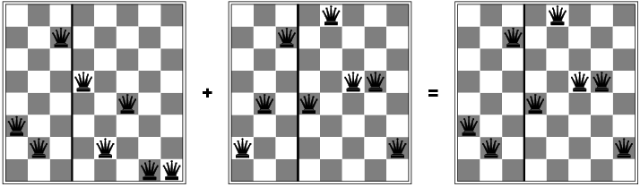
8-Queens problem using Genetic algorithms

Slide 27
Issues
How to select original population?
How to handle non-binary solution types?
What should be the size of the population?
What is the optimal mutation rate?
How are mates picked for crossover?
Can any chromosome appear more than once in a population?
When should the GA halt?
Local minima?
Parallel algorithms?

Slide 28
Evolutionary Computation
Algorithms + Data Structures = Programs (N.Wirth)
Genetic Algorithms + Data Structures = Evolution Programs
Evolution Programs can be perceived as a generalization of genetic algorithms.
Classical genetic algorithms operate on fixed length binary strings, which need not be the case for evolution programs.
Evolution programs usually incorporate a variety of genetic operators, wherever classical genetic algorithms use binary crossover and mutation.

Slide 29
Application Areas
Search
Optimization
Machine Learning

Slide 30
Evolutionary Computation
Genetic algorithms
Genetic Programming
Evolution Strategies
Evolutionary Programming

Slide 31
Structure of an Evolution Program
Procedure evolution program
begin
t =0
initialize P(t)
evaluate P(t)
while(not(termination condition) do
begin
t = t+1
select P(t) from P(t-1)
alter P(t)
evaluate P(t)
end
end

Slide 32
Genetic Algorithm Approach
Problem
Genetic
Algorithm
Modified Problem
GA operate on binary strings, require a modification of an original problem into appropriate (suitable for GA) form. This include a mapping between solution and its binary representation.

Slide 33
Evolution Program Approach
Problem
Genetic
Algorithm
Evolution Program
Evolution Programs leave the problem unchanged, modifying a chromosome representation of a solution (using natural data structure ) and applying appropriate genetic operators.

Slide 34
To solve a non-trivial problem using an evolution program
transform the problem into a form appropriate for the genetic algorithm (classical GA approach)
transform the genetic algorithm to suit the problem (second approach)

Slide 35
Genetic Algorithms vs. Traditional Methods
GAs search from a population of points, not a single point.
GAs use payoff (objective function) information, not derivatives or other auxiliary knowledge.
GAs use probabilistic transition rules, not deterministic rules.

Slide 36
Hill climbing, simulated annealing and genetic algorithms
funny message which was presented recently on the internet
In the Hill-climbing method , the kangaroo can hope at best to find the top of a mountain close to where he starts. There is no guarantee that this mountain will be Everest or even a very high mountain. Various methods are used to try to find the actual.global optimum.
In simulated annealing, the kangaroo is drunk and hops around randomly for a long time. However, he gradually sobers up and tends to hop up hill.

Slide 37
In genetic algorithms, there are lots of kangaroos that are parachuted into the Himalayas (if the pilot did not get lost) at random places. These kangaroos do not know that they are supposed to be looking for the top of Mt. Everest. However, every few years, you shoot the kangaroos at low altitudes and hope the ones that are left will be fruitful and multiply.

Slide 38
References for genetic algorithms
Goldberg D.E. : Genetic Algorithms in Search, Optimization and Machine Learning, Addison-Wesley, 1989.
.Michalewicz Z.: Genetic Algorithms +Data Structures =Evolution Program, Springer , 1999.

